Slide 1
APIs and Project Design
Nutrition Analysis

Slide 2
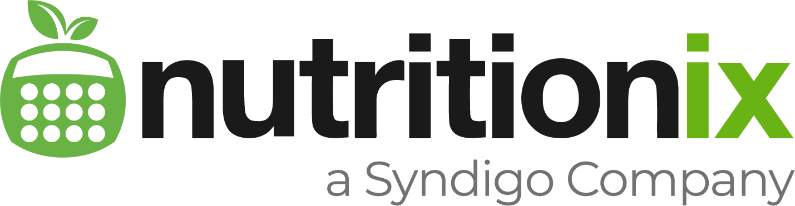
- 726,595 items from 35,536 grocery brands, 158,760 items from 794 restaurants, 13,081 Common Foods
- In accordance with USDA (United States Department of Agriculture)
- Here, we can get all forms of data regarding nutrition like proteins, fats, sugars, calories and so on.
- Voice and text based identification of nutritional values of food items.
- Built in NLP.
- Only upto 2 active users and no Uptime Guarantee for free version
- Request to add custom foods to database – like food items of certain brands involves having the most premium version – Unicorn starts at 1250$ per month

Slide 3
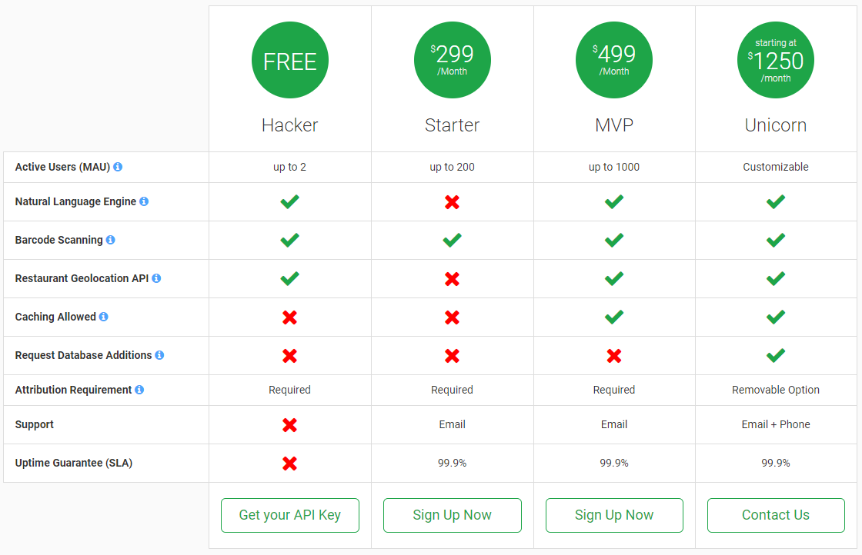

Slide 4
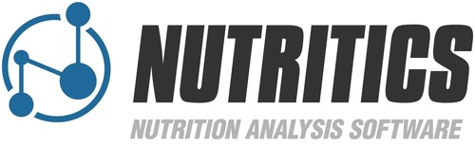
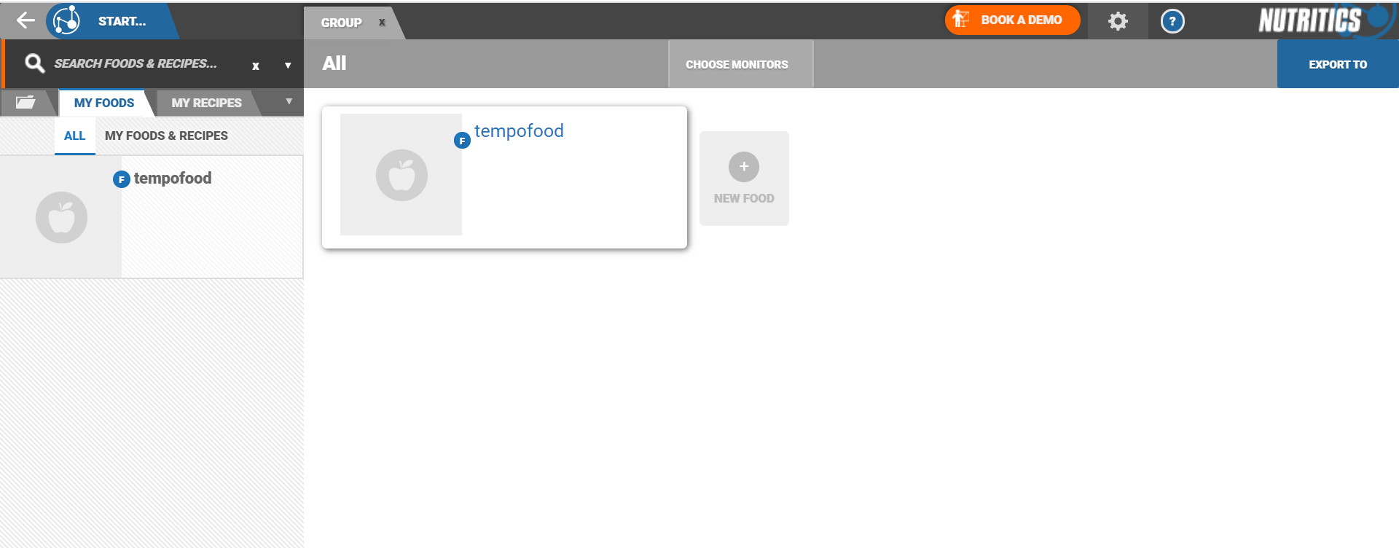
- Access over 800,000 foods nutrition, recipe and food-related data from official national & international and branded food databases for multiple regions.
- Each database is available in the local language(s) and in English. Includes a large database of universal Arabic foods.
- Here, we can get all forms of data regarding nutrition like proteins, fats, sugars, calories and so on.
- Can create clients to manage their food routines.
- Paid
The HTTP REST API with basic authentication done in the header supports both HTTP GET & HTTP POST methods and returns JSON format results, compatible with all common coding languages. Response time is on average < 200ms with a 99.99% server uptime

Slide 5

DATASET DOWNLOAD:
https://fdc.nal.usda.gov/download-datasets.html
FoodData Central is an integrated data system that provides expanded nutrient profile data and links to related agricultural and experimental research.
Convenient Nutritional API.
Most of the prior API are majorly based on the USDA dataset along with their own modifications.
Free to use, FoodData Central currently limits the number of API requests to a default rate of 3,600 requests per hour per IP address, as this is adequate for most applications.

Slide 6
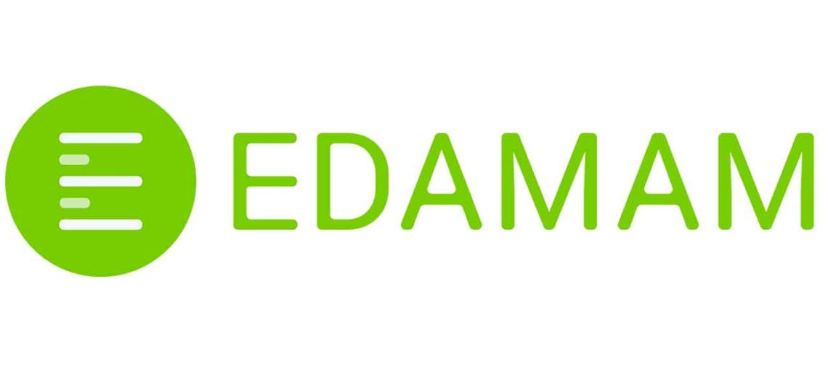
The Nutrition Analysis API uses Natural Language Processing and semantically structured data.
Inaccurate NLP, works with at max two different food items and in this case also there is a possibility of error.
Edamam provides access to a food and grocery database with over 750,000 basic foods, restaurant items and consumer packaged foods
For basic foods from the food database (flour, eggs, flour etc.), Edamam returns data for calories, fats, carbohydrates, protein, cholesterol, sodium for a total of 28 nutrients. For UPC foods and fast foods data is return as listed on their nutrition label
Submit the full text of any recipe or ingredient list. Edamam will extract the full nutrition and ingredient data from the text. No more need to spend hours entering your recipes line by line. The nutrition analysis takes less than a second!

Slide 7
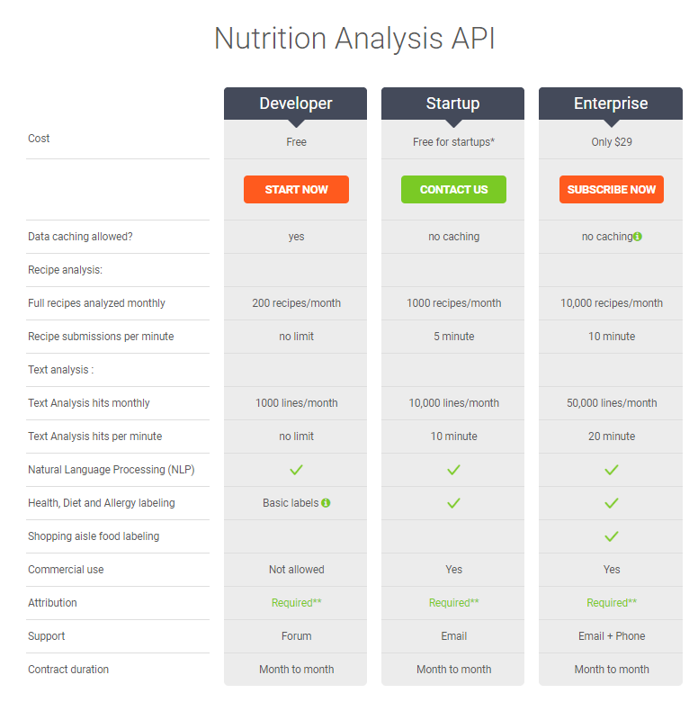
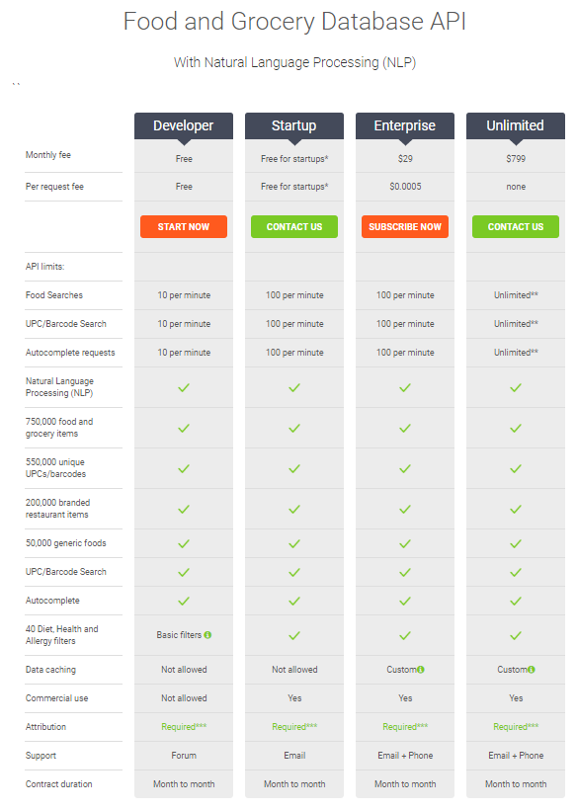

Slide 8
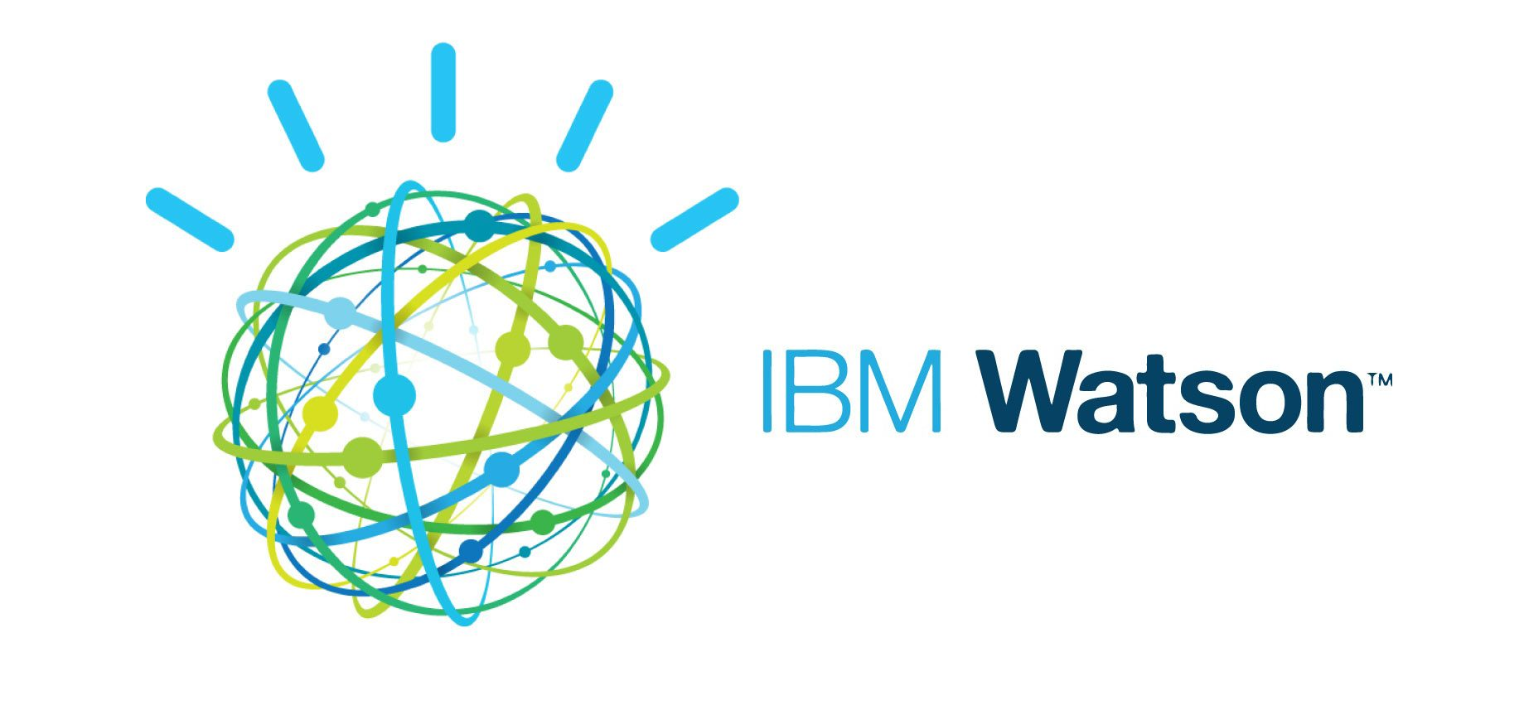



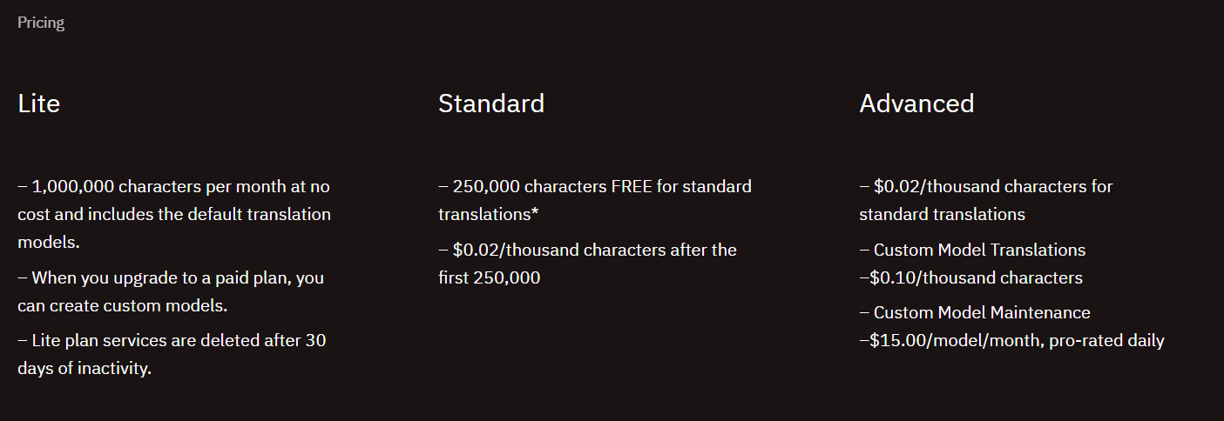
Translation, NLP API
The daily request limit is 1,000,000 characters. The monthly limit is 10,000,000 characters. To increase the request limit, switch to the fee-based version of the service.
Azure Subscription
All NLP APIs can identify keywords but in entity identification – it cannot identify food, researched online no proper NLP to identify food.

Slide 9

Project Idea:
DATBASE: FIREBASE / Postgres
Username
Password
User Date Nutrients
Nutrition value by date

